Slide 1
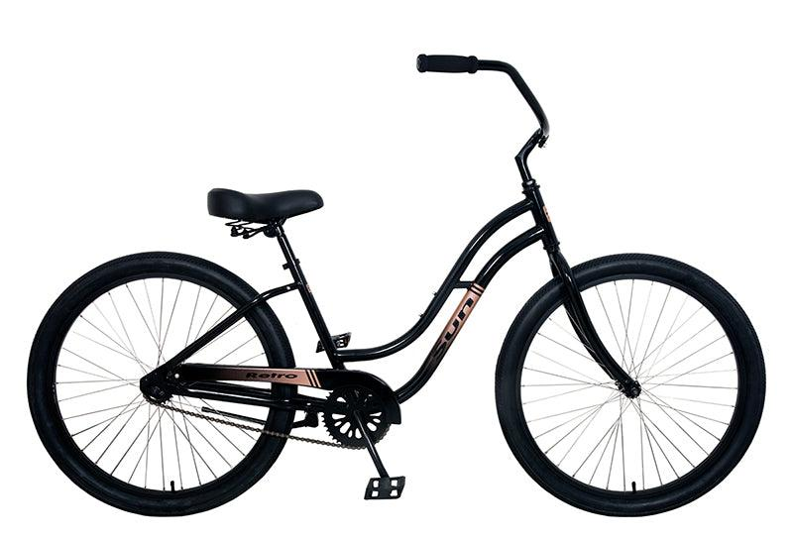
Bike Store Management System
- Pranay Reddy Gundala
- Geethika Elaprolu
- Yatharth Kapadia

Slide 2
Scenario
Company: PGK BikeStore Corp
Purpose:
The creation of a database to enhance the management of a bicycle retail chain. This project focuses on improving:
Real-time inventory tracking across multiple store locations.
Efficient management of sales transactions and customer data.
Streamlined supply chain operations, from product orders to store-level stock management.
Data-driven insights for decision-making in sales, inventory, and customer engagement.
Intended Users:
Store Managers: Manage inventory levels, analyze sales trends, and track staff performance.
Sales Associates: Access product details, assist customers, and process transactions efficiently.
Inventory Managers: Track stock across stores and coordinate with suppliers for replenishments.
Customers: Indirectly benefit from smoother transactions and accurate product availability updates.

Slide 3
Data Source
Data from a sample relational database representing real-world operations of a bike store, sourced from SQL Server Sample Database
Entities included in the database:
Customers: Information on customer details and transaction history.
Staffs: Data on employees, their roles, and management relationships.
Products: Catalog of bicycles and accessories with pricing, brands, and categories.
Orders: Transaction details including dates, statuses, and associated customers and staff.
Stores: Information on store locations and contact details.
Brands: Data on manufacturers of products.
Categories: Classification of products into different types (e.g., mountain bikes, road bikes).
Order Items: Detailed information about the items in each order.
Stocks: Inventory details linking products to store locations

Slide 4
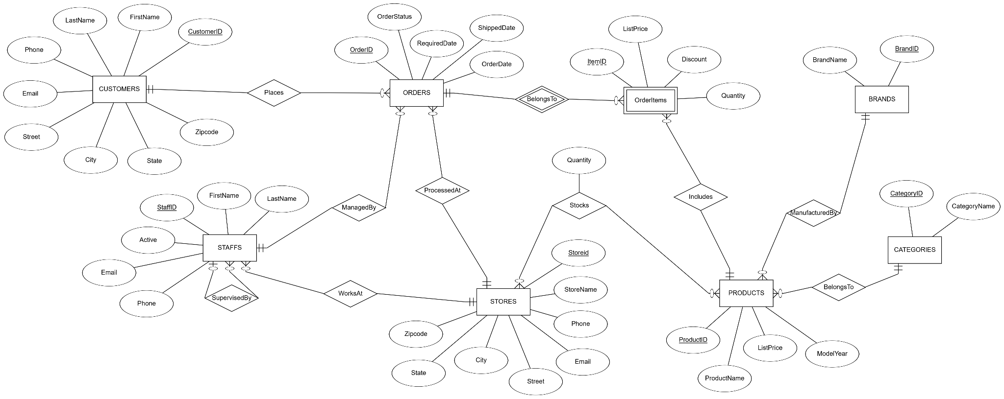
ERD

Slide 5
Database Relationships Description
Customers → Orders (1:M): Each customer can place multiple orders, but each order is associated with one customer.
Orders → Order Items (1:M): Each order can consist of multiple items, but each item belongs to one specific order.
Products → Order Items (1:M): Each order item includes one product, but a product can appear in multiple order items.
Staff → Orders (1:M): Each order is managed by a single staff member, but a staff member can manage multiple orders.
Products ↔ Stocks (M:M): Products can be stocked in multiple stores, and each store can stock multiple products.
Products → Categories (M:1): Each product belongs to a single category, and each category can include multiple products.
Products → Brands (M:1): Each product is manufactured by a specific brand, and each brand can manufacture multiple products.
Staff ↔ Staff (Recursive Relationship): Staff members can supervise other staff, forming a hierarchy.
Stores → Staff (1:M): Each store can employ multiple staff members, but a staff member is linked to one store.

Slide 6
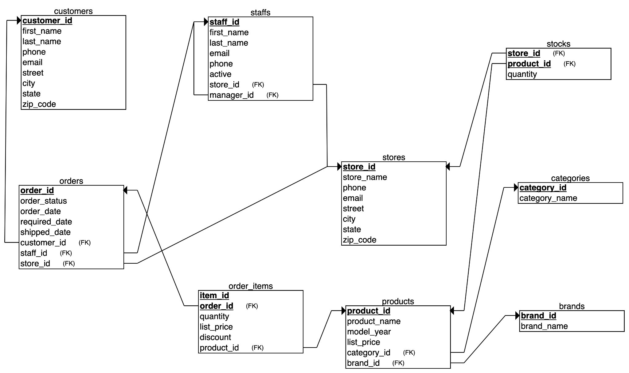
Relational Schema

Slide 7
Design Decisions
Data Normalization: The database schema follows 3NF to eliminate redundancy and improve data consistency. Each attribute depends only on the primary key, and tables are decomposed logically.
Entity Relationships: The Order Items entity is designed as a dependent (weak) entity, linking Orders and Products with a composite primary key (order_id, item_id) to maintain referential integrity.
Recursive Hierarchy: The Staff entity includes a recursive relationship (supervised_by) to represent management hierarchies within stores effectively.
Data Types and Constraints:
Consistent Data Types: Fields like list_price use DECIMAL for precision in financial data.
Constraints: Foreign key constraints ensure data consistency across entities. Example: Cascading updates and deletes for product_id and order_id.

Slide 8
Queries
The 10 SQL queries we designed provide actionable insights into sales, inventory, and customer engagement. These leverage techniques such as:
Joins: Inner Join, Outer Join (LEFT JOIN)
Conditional Logic: CASE Statements
Aggregate Functions: SUM, AVG, COUNT
Grouping and Filtering: GROUP BY
Sorting: ORDER BY
Handling NULLs: COALESCE, IS NULL
Advanced Features: DATEDIFF, Mathematical Operations

Slide 9
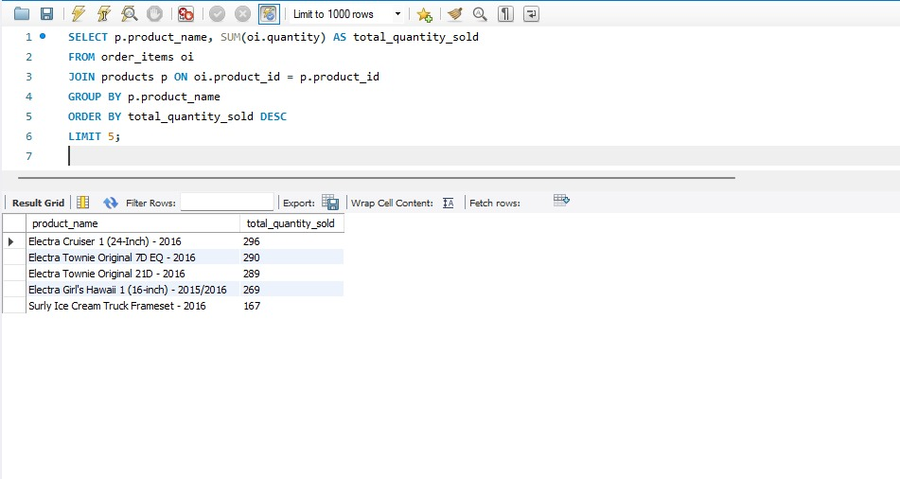
1. Top 5 Selling Products by Quantity Across All Stores

Slide 10
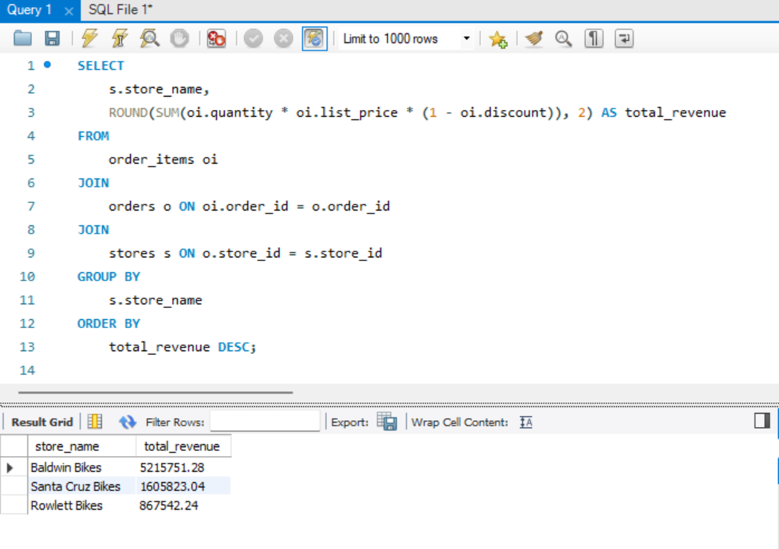
2. Revenue Generated by Each Store

Slide 11
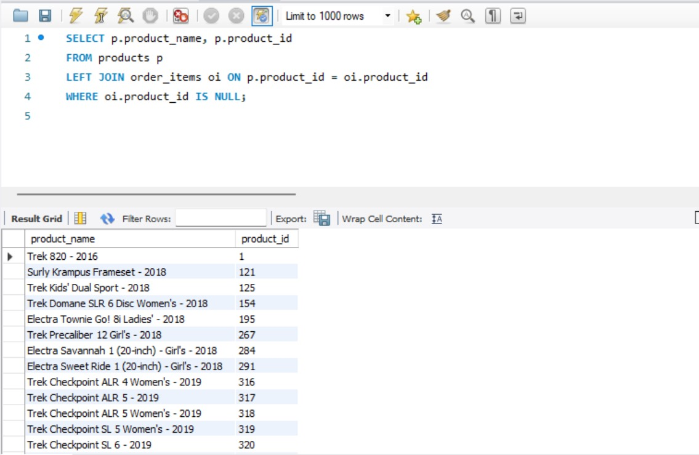
3. Unsold Products Across All Stores

Slide 12
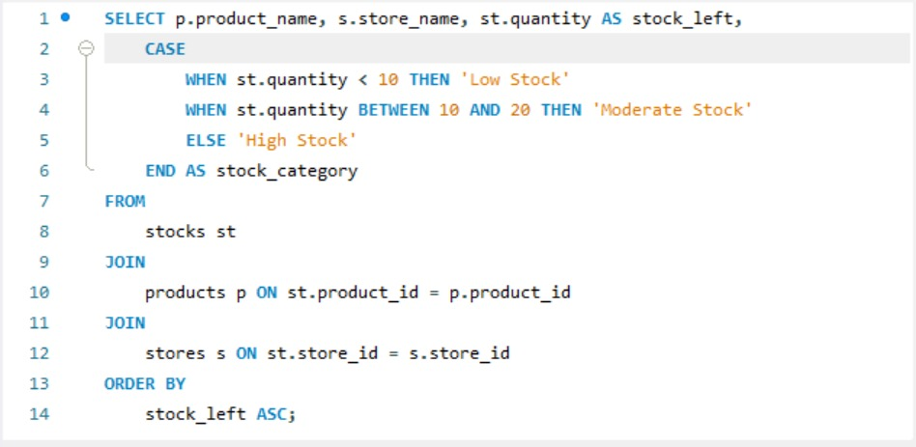
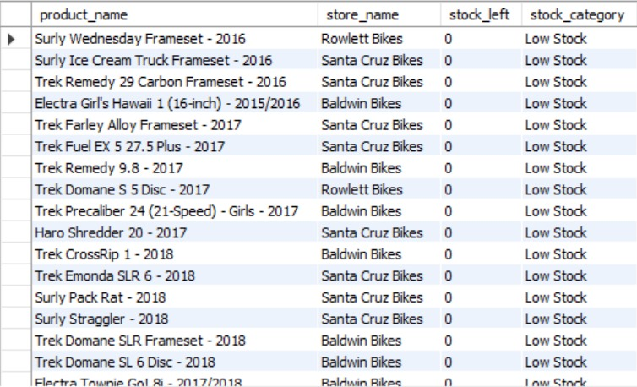
4. Categorized Stock Levels

Slide 13
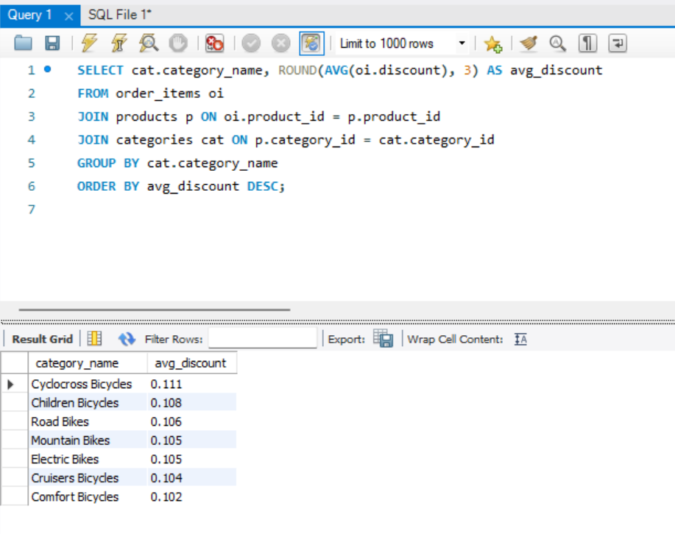
5. Average Discount Applied Per Category

Slide 14
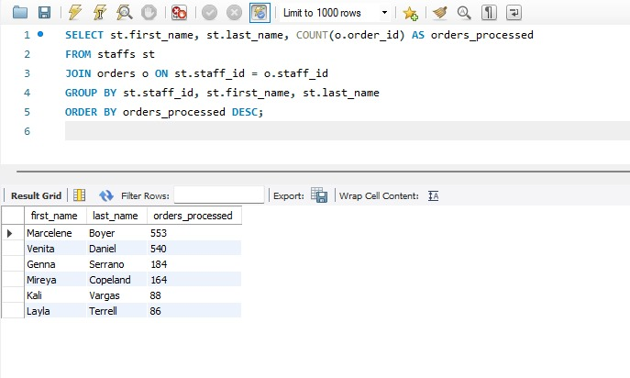
6. Orders Processed by Each Staff Member

Slide 15
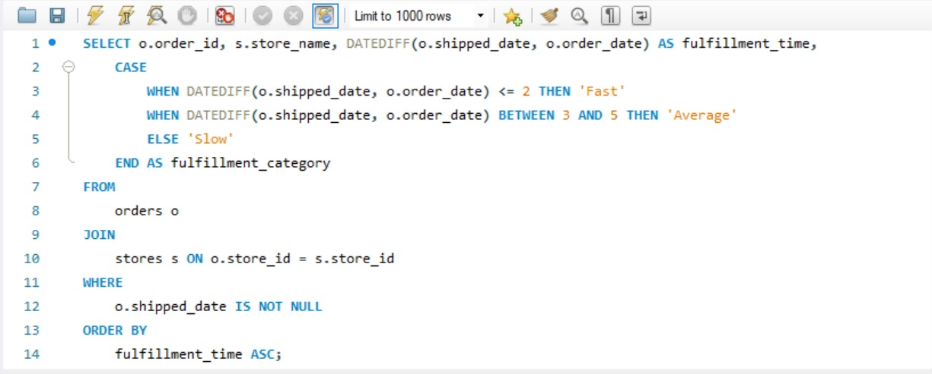
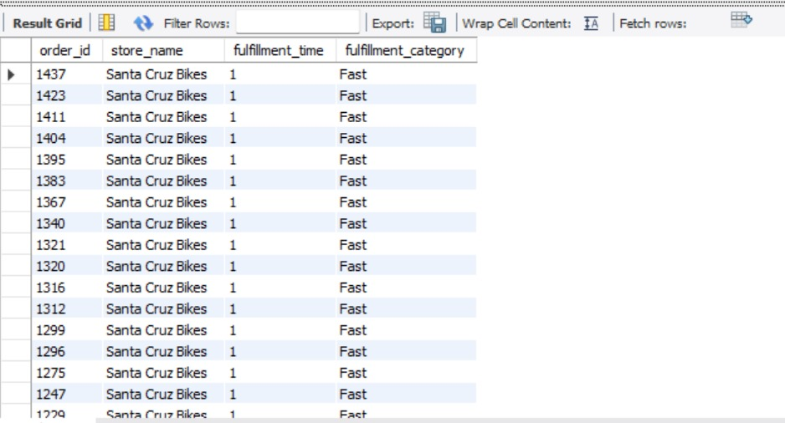
7. Order Fulfillment Analysis

Slide 16
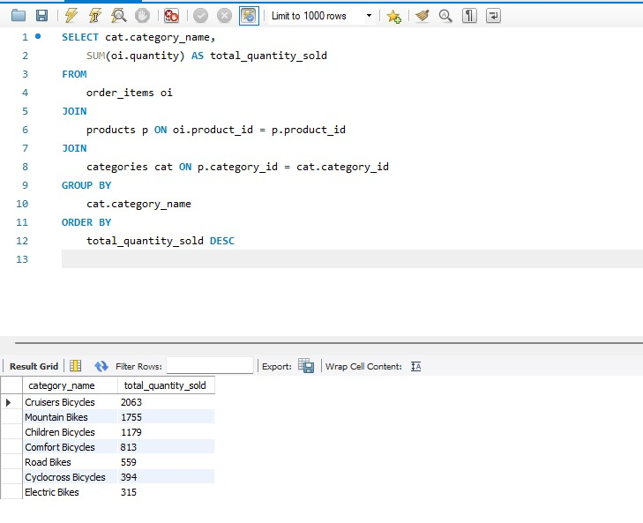
8. Total Items Sold Per Product Category

Slide 17
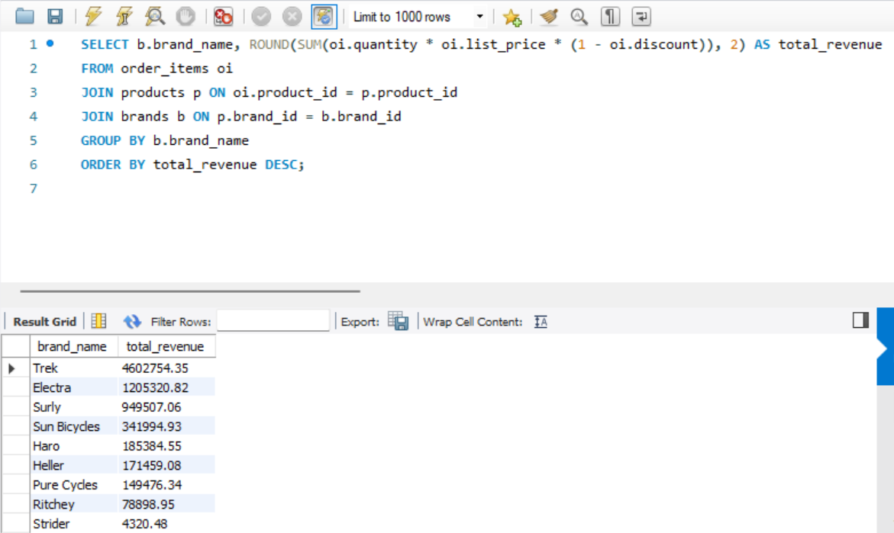
9. Total Revenue per Brand

Slide 18
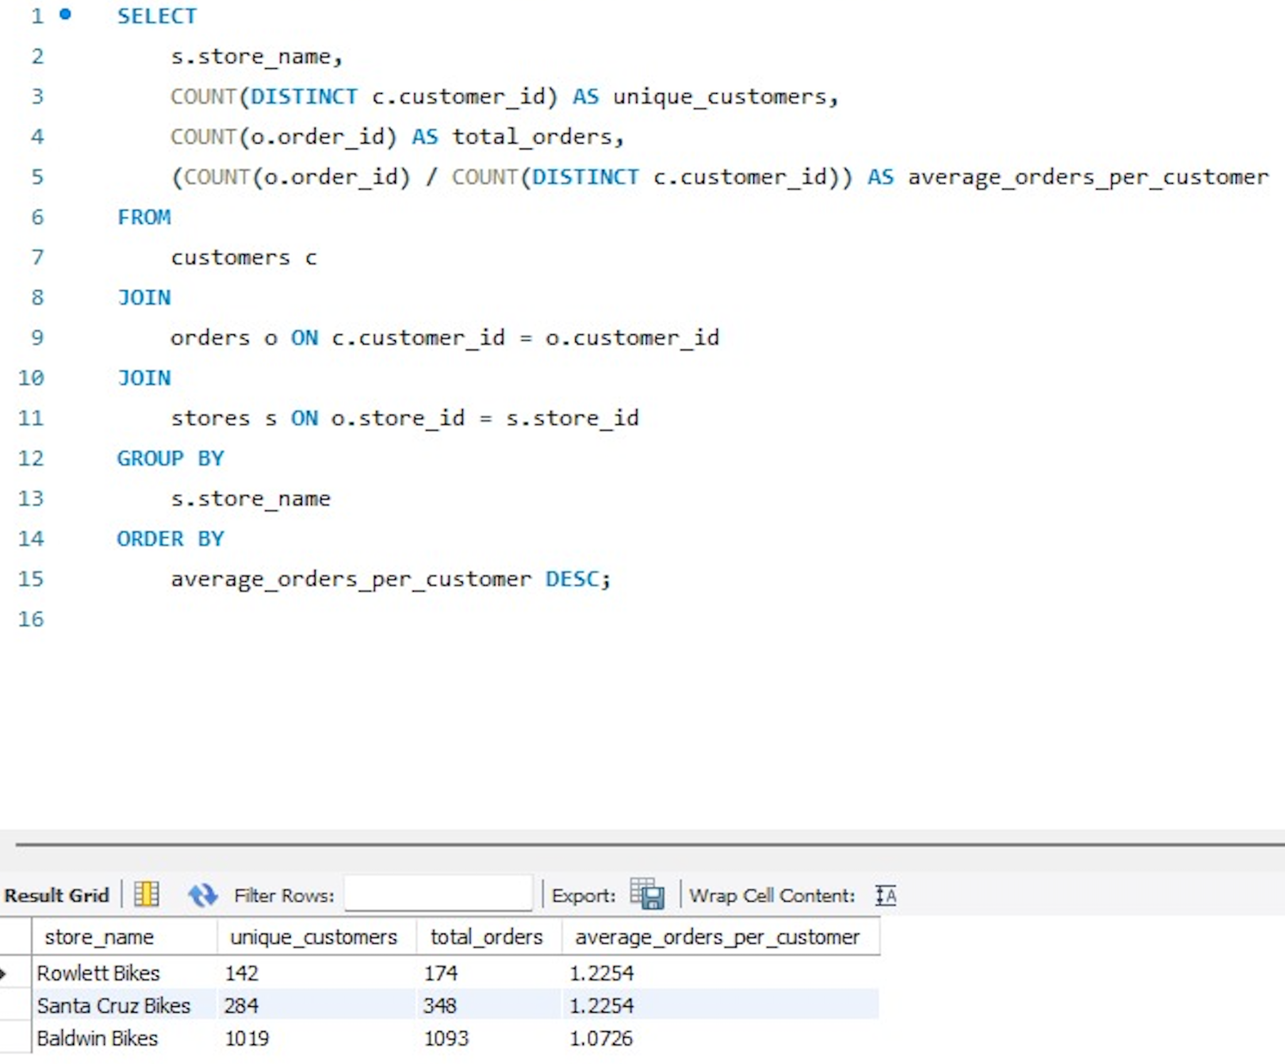
10. Customer retention by Store

Slide 19
Insights and Future Directions for the PGK BikeStore Database
1. Primary Findings:
Efficient Data Integration: Seamless integration of sales, inventory, and customer data has significantly enhanced operational efficiencies.
Improved Decision-Making: Real-time data availability has empowered managers to make informed decisions rapidly.
Enhanced Customer Experience: The database has enabled personalized customer interactions, improving engagement and satisfaction.
2. Recommendations for Improvement:
Scaling Database Capacity: As store numbers increase, scaling the database to handle more transactions, larger datasets, and simultaneous accesses without performance lag.
Upgrading Database Design:
Implementing Cloud Solutions: Migrating to cloud-based solutions for better scalability and flexibility.
Enhancing Data Security Measures: As data grows, enhancing security protocols to protect sensitive customer and business information.

Slide 20
Insights and Future Directions for the PGK BikeStore Database
3. Anticipated Challenges:
Data Migration Complexities: Moving existing data to a new structure or platform could lead to temporary disruptions and data integrity issues.
Cost Implications: Upgrading and scaling the database may incur significant costs in terms of new hardware, software, or cloud service subscriptions.
Performance Optimization: As data volume grows, maintaining the speed and efficiency of data processing becomes increasingly challenging.

Slide 21
References
[1] Bike Store Relational Database | SQL
[2] SQL Server Sample Database
[3] https://data.world/**
[4] https://en.wikipedia.org/**

Slide 22
Thank you

